Slide 1

JobNexus
(Job Portal Application)
Akriti Chapagain
Binaya Koirala

Slide 2
INTRODUCTION
Job Nexus is an upcoming mobile application that aims to improve the job search process.
Establishing partnerships with local organizations to provide job vacancies for semi-skilled manpower and entry-level positions.
Empowering individuals through skill development and career opportunities.

Slide 3
PROBLEM STATEMENT
Lacks collaborations with local businesses.
Semiskilled workers, like plumbers and construction workers, faces a scarcity of job listings.
In the absence of dedicated platforms, for registering volunteers during events.
There aren't many apps that bring together different training and workshop programs.

Slide 4

OBJECTIVES
To establish collaborations with local businesses to broaden job access and ensure rural inclusion and semi-skilled job potentials.
To implement advance filter to better match job seekers with suitable roles based on their skills.
To create a unified platform for users to easily find and enroll in diverse training programs, volunteers, fostering skill development

Slide 5
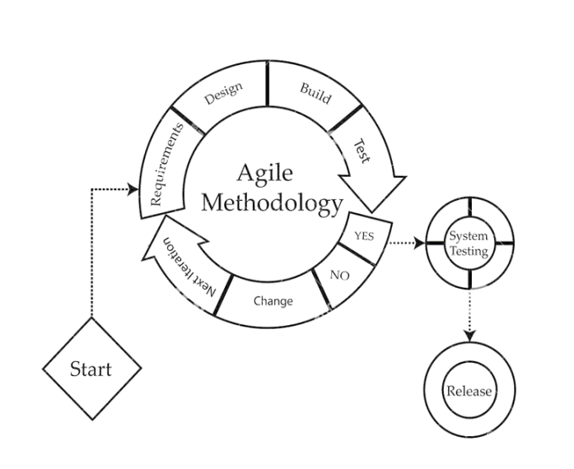
METHODOLOGY

Slide 6
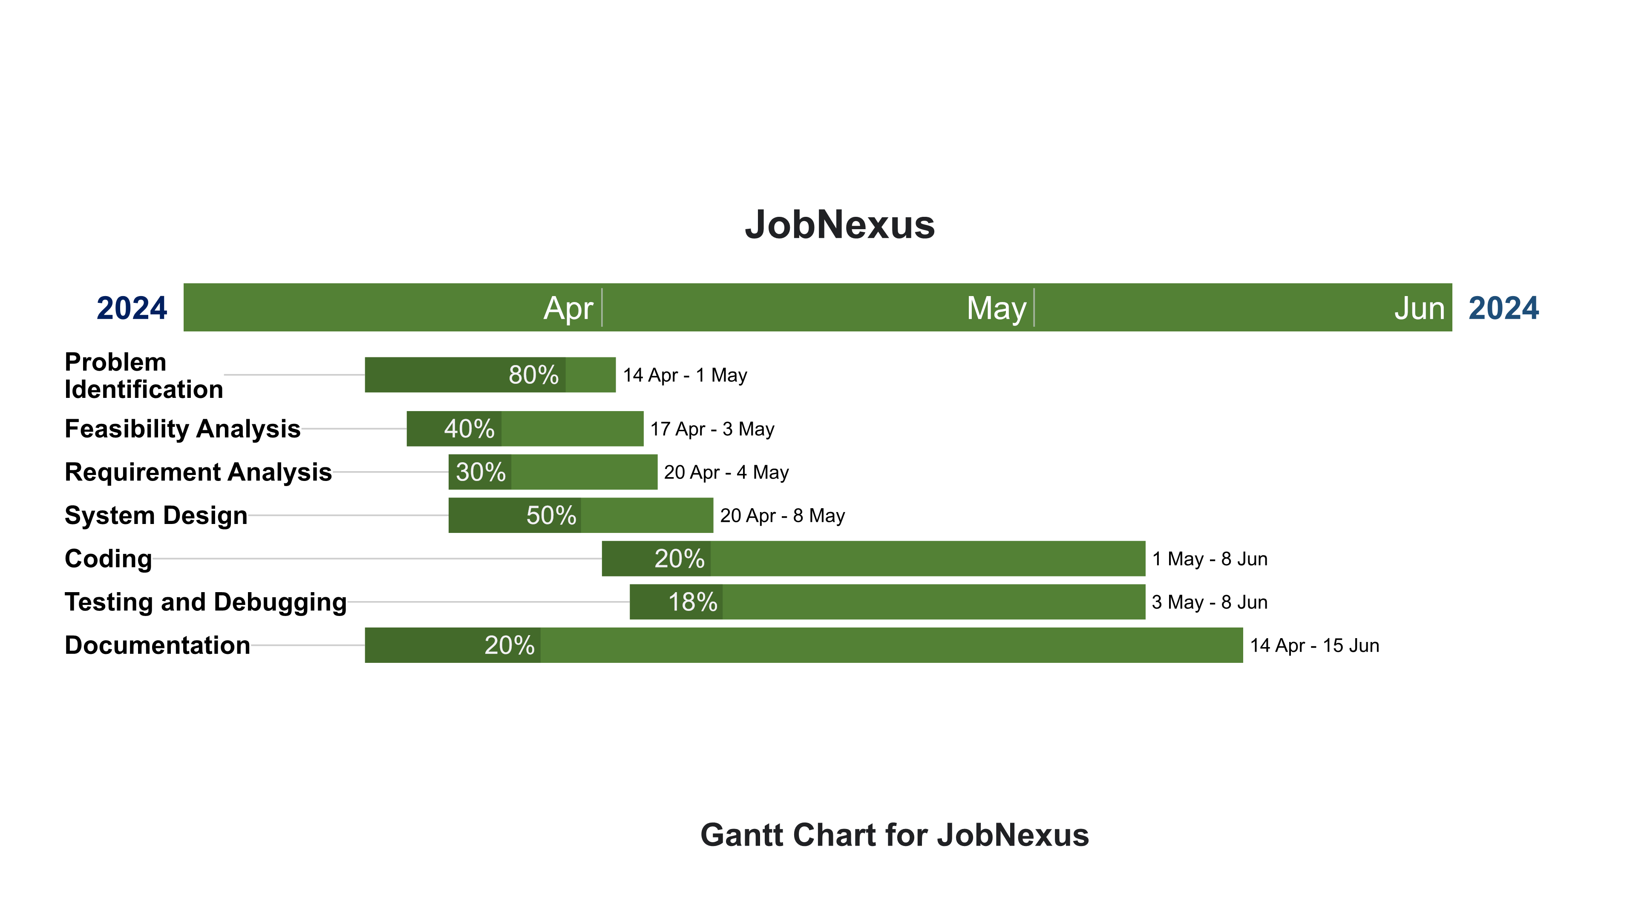
GANTT CHART

Slide 7
DELIVERABLES
Establish partnerships for diverse job listings.
Connect job seekers with varying skills to entry-level positions.
Simplify job search and application processes.
Enable easy resume uploads and matching.
Provide simplified job posting and application management.
Offer training programs and volunteer opportunities.

Slide 8
Thank You :)

